Slide 1
Outlier Detection & Handling
A Beginner's Guide to Finding and Managing Data Anomalies

Slide 2

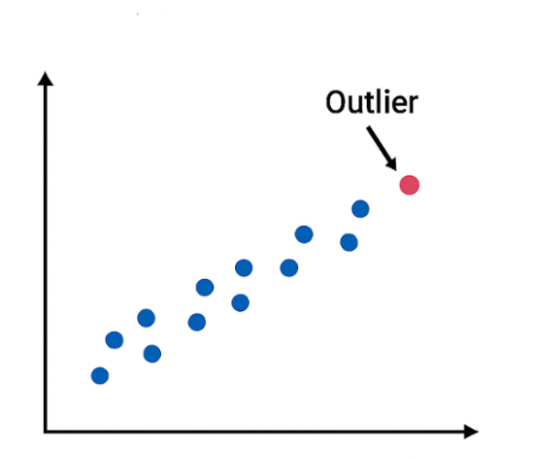
What is an Outlier?
An outlier is a data point that differs significantly from other observations in your dataset.
Think of it as the "odd one out." It could be a billionaire moving into a middle-class neighborhood, or a sudden spike in website traffic due to a viral post.
Outliers can be caused by genuine variability in the real world, or they can simply be data entry errors.

Slide 3






Why Do Outliers Matter?
Skewed Averages
Model Disruption
Hidden Insights
A single extreme value can drastically pull the "Mean" (average) up or down, giving a false impression of what is considered normal.
Machine learning models try to find general patterns. Outliers confuse algorithms, causing them to make less accurate predictions.
Sometimes, the outlier IS the insight! In fields like fraud detection or medical diagnosis, the anomaly is exactly what you want to find.

Slide 4
1. Detection Methods
How do we mathematically identify the anomalies?

Slide 5


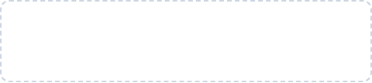

The Z-Score Method
The Concept
The Formula
The Z-score measures exactly how many Standard Deviations a data point is away from the mean.
If your data follows a normal "Bell Curve" distribution, nearly all normal data sits close to 0. Anything too far out is flagged as an outlier.
x = Data Point | μ = Mean | σ = Standard Deviation

Slide 6

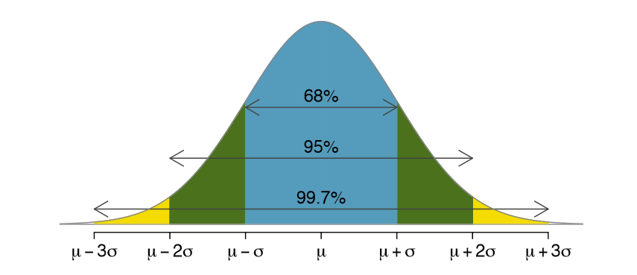
Visualizing Z-Scores
In the Z-score method, we typically use a threshold of +3 or -3.
If Z > 3, the value is abnormally high.
If Z < -3, the value is abnormally low.
Because 99.7% of data in a normal distribution falls within 3 standard deviations, anything beyond these "tails" is highly unusual.

Slide 7

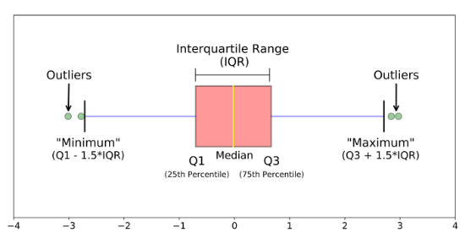
The IQR Method
The Interquartile Range (IQR) focuses on the middle 50% of your data.
Unlike the Z-score, the IQR method does NOT require your data to follow a perfect bell curve. It is based on medians and percentiles, making it highly robust against extreme values.
We visualize this method using a Box Plot.

Slide 8
The 1.5x Multiplier
Setting the "Fences"
1.5
To detect outliers using IQR, we build invisible boundaries (fences) around our data:
Lower Bound: Q1 - (1.5 × IQR)
Upper Bound: Q3 + (1.5 × IQR)
The Magic Constant
Any data point that falls below the lower bound or above the upper bound is officially classified as an outlier.

Slide 9
2. Handling Methods
We found them. Now what do we do with them?

Slide 10

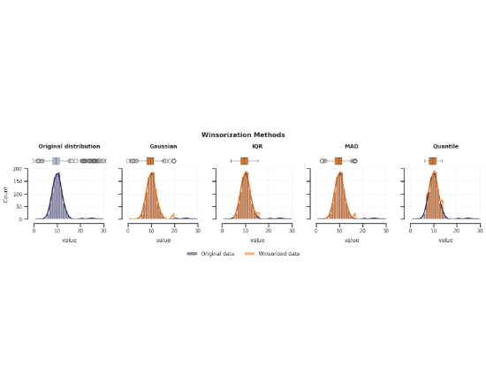
The Winsorization Method
Deleting outliers means losing data. Winsorization offers an alternative: we "cap" the extreme values.
For example, if we cap data at the 1st and 99th percentiles:
Any value above the 99th percentile is replaced by the exact 99th percentile value.
Any value below the 1st percentile is replaced by the 1st percentile value.
This prevents extremes from distorting the mean while keeping our dataset size intact.

Slide 11


The Pragmatic Approach
Iterative Testing
Data science is often about trial and error. Don't blindly apply one rule!
Run your analysis or train your model three ways: keeping outliers, deleting outliers, and capping outliers. Compare the final results to see which yields the highest accuracy.

